Slide 1
Selecting a city for Opening a Restaurant
By: Durga Shankar Singh

Slide 2
INTRODUCTION
Restaurants provide the best business opportunity for small scale investors and businessmen.If the quality of food,service and ambience of a restaurant is satisfactory then the restaurant ensures the inflow of customers and provide a steady income to the owner.
However,due to increase in the number of restaurants,opening a new profitable restaurant requires a lot of planning.Therefore profitable restaurant business is all about finding your niche customers and serving them the food that they want.Nowadays restautants specialized in giving a particular type of food are getting more popular.Hence the type of food is the first criteria to decide for opening a new restaurant.After the food,location plays a crucial role in the inflow of loyal customers.

Slide 3
OBJECTIVES
The objective of this project is to generate a list of cities with highest number of user defined restaurants.
If a city has more number of restaurants(For e.g. Indian restaurants),it clearly indicates more numbers of customers are present in that city who are willing to eat Indian food.
Hence Opening a new Indian restaurant in that city will bring more inflow of customers leading to increase in profit.

Slide 4
DATA USED
For this project following two types of data are used.
FOURSQUARE API :This api will be used to search for all the venues(For e.g. Indian ) present in a City serving a particular type of customers.From these list of venues only restaurants data(For e.g. Indian Restaurant) will be selected.
2.Kaggle(https://www.kaggle.com/mahbubrob/usa-cities#usa_cities.csv) :This database is will be used to get the longitude and latitude of all the cities.Subsequently this data will be used for querying in Foursquare api.

Slide 5
METHODOLOGY
GET THE LOCATION DATA OF ALL CITIES
QUERY FOR THE TYPE OF RESTAURANT
USE FOURSQUARE API TO SEARCH VENUES
FILTER RESTAURANTS FROM ALL VENUES
COUNT THE NO OF RESTAURANTS FOR EACH CITY
PREPARE NEW LIST OF CITIES WITH RESTAURANT COUNT

Slide 6
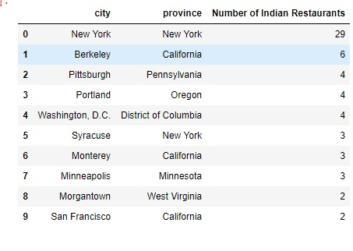
LIST OF CITIES WITH NO OF RESTAURANTS

Slide 7
CONCLUSION
In conclusion,this project is prepared to help the businessman and investors in getting the best cities to open a restaurant where more customers are willing to pay for the food.This will reduce their cost of marketing and more focus will be on serving quality food and service to the customer.Happy customers will make the restaurant business more profitable.

